Slide 1
1
FUNCTIONS AND LIMITS
.

Slide 2
1.4
Calculating Limits
.

Slide 3
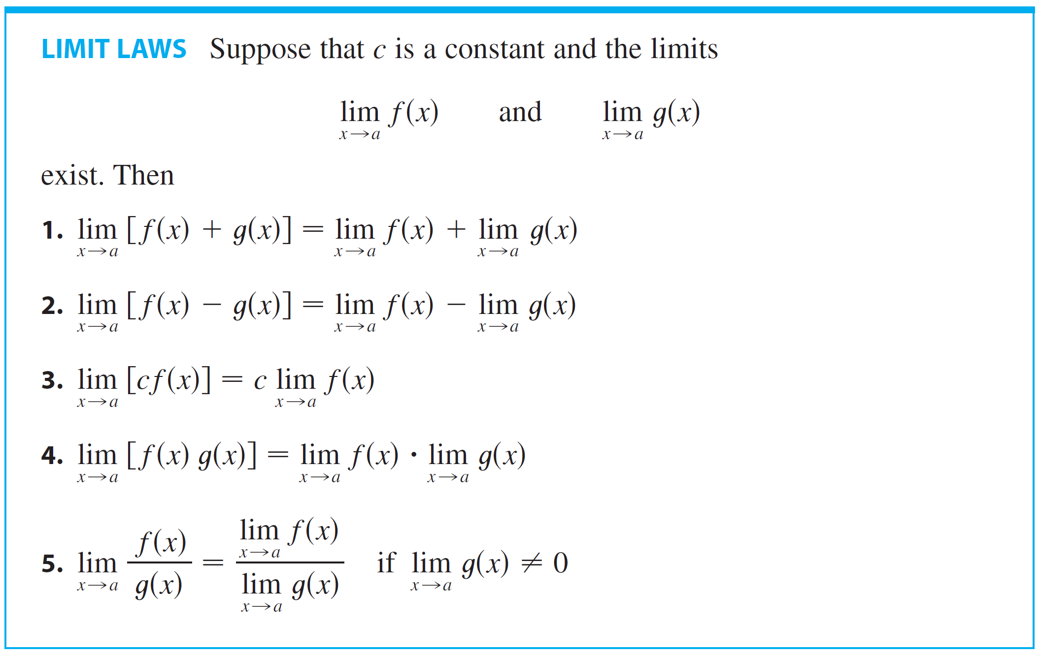
Calculating Limits
In this section we use the following properties of limits, called the Limit Laws, to calculate limits.

Slide 4
Calculating Limits
These five laws can be stated verbally as follows:
Sum Law
The limit of a sum is the sum of the limits.
Difference Law
The limit of a difference is the difference of the limits.
Constant Multiple Law
The limit of a constant times a function is the constant times the limit of the function.

Slide 5
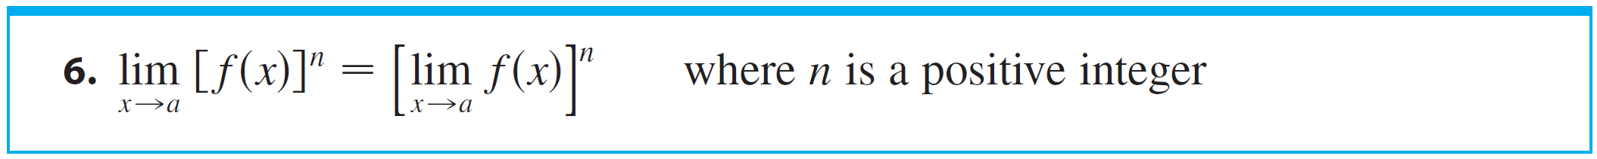
Calculating Limits
Product Law
The limit of a product is the product of the limits.
Quotient Law
The limit of a quotient is the quotient of the limits (provided that the limit of the denominator is not 0).
If we use the Product Law repeatedly with g(x) = f (x), we obtain the following law.

Slide 6
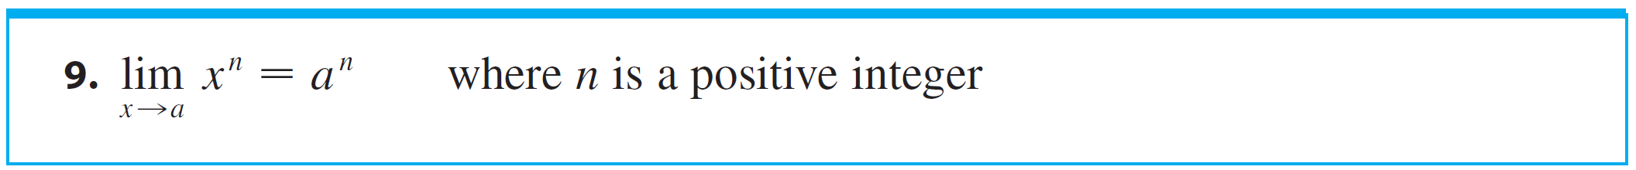
Calculating Limits
In applying these six limit laws, we need to use two special limits:
If we now put f (x) = x in Law 6 and use Law 8, we get another useful special limit.

Slide 7
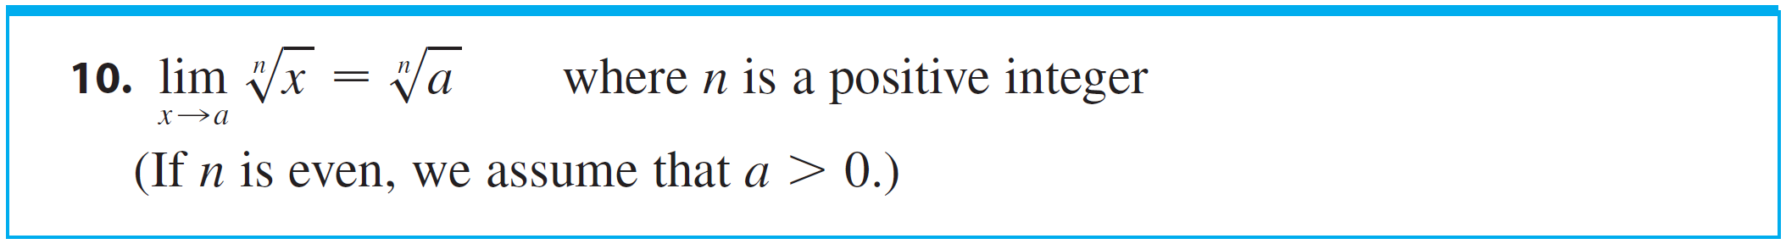
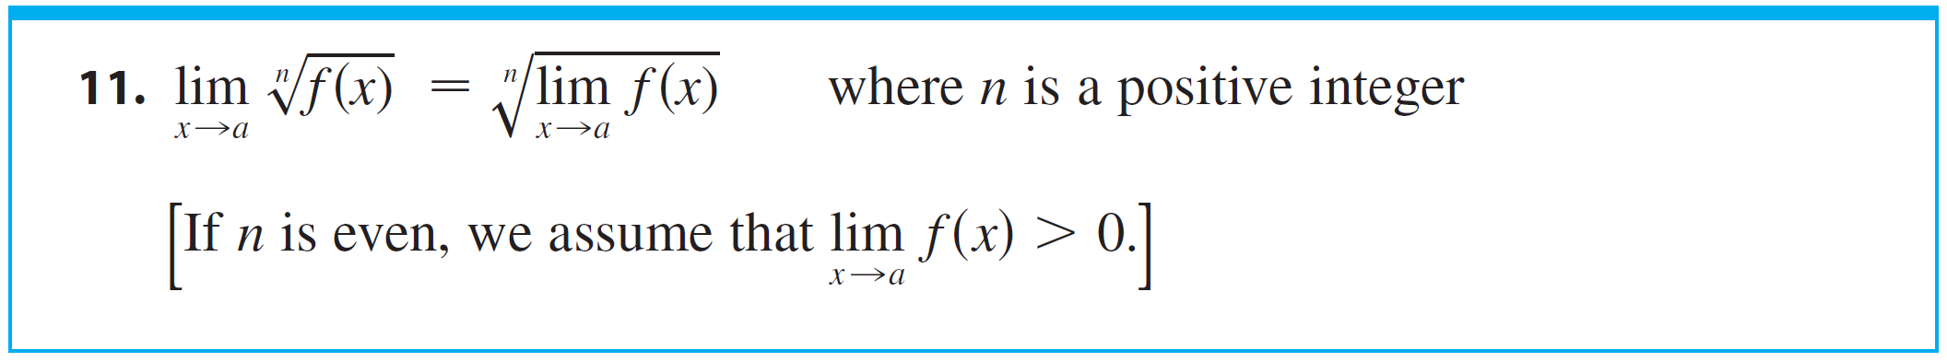
Calculating Limits
A similar limit holds for roots as follows.
More generally, we have the following law.

Slide 8
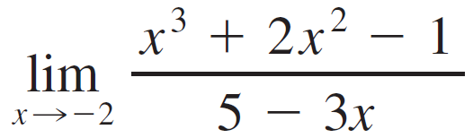


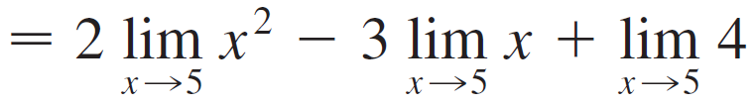

Example 1
Evaluate the following limits and justify each step.
(a) (b)
Solution:
(a)

Slide 9



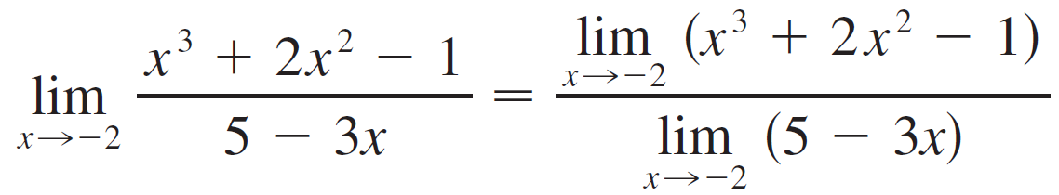

Example 1 – Solution
cont’d
(b) We start by using Law 5, but its use is fully justified only at the final stage when we see that the limits of the numerator and denominator exist and the limit of the denominator is not 0.

Slide 10
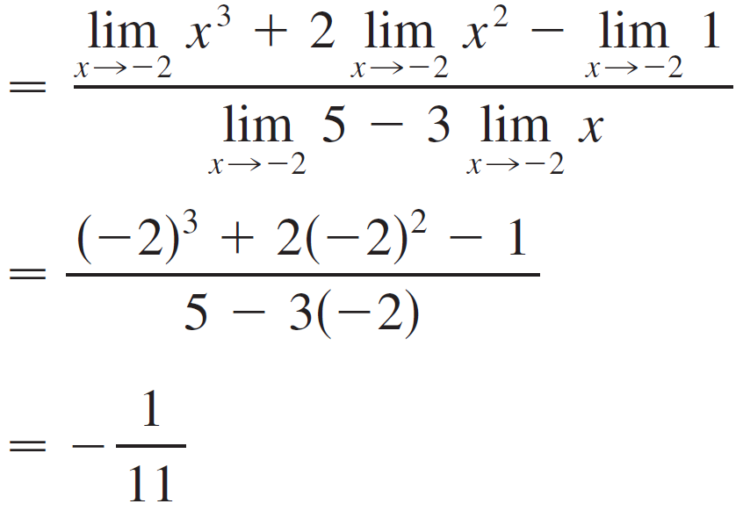

Example 1 – Solution
cont’d

Slide 11
Note
If we let f(x) = 2x² - 3x + 4, then f(5) = 39.
In other words, we would have gotten the correct answer in Example 1(a) by substituting 5 for x.
Similarly, direct substitution provides the correct answer in Example 1(b).
The functions in the example are a polynomial and a rational function, respectively.
Similar use of the Limit Laws proves that direct substitution always works for such functions.

Slide 12
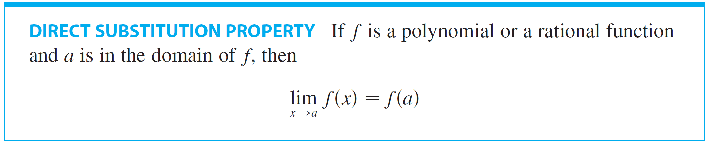
Calculating Limits
The trigonometric functions also enjoy the Direct Substitution Property.

Slide 13
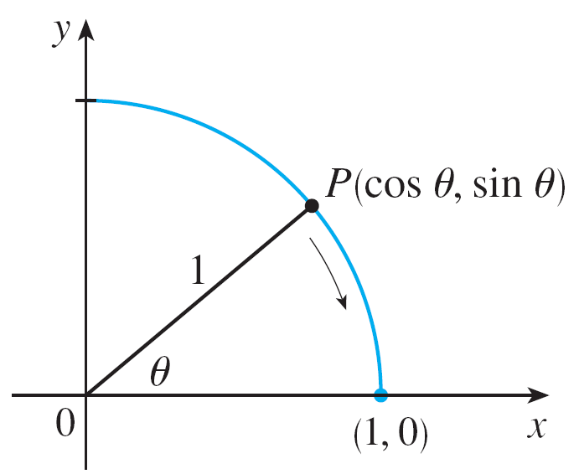
Calculating Limits
We know from the definitions of sin θ and cos θ that the coordinates of the point P in Figure 1 are (cos θ, sinθ).
Figure 1

Slide 14

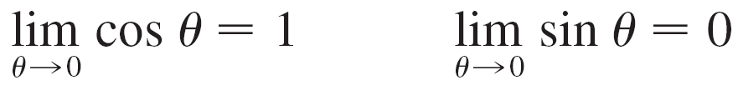

Calculating Limits
As θ → 0, we see that P approaches the point (1, 0) and so cos θ → 1 and sin θ → 0.
Thus
Since cos 0 = 1 and sin 0 = 0, the equations in assert that the cosine and sine functions satisfy the Direct Substitution Property at 0.
The addition formulas for cosine and sine can then be used to deduce that these functions satisfy the Direct Substitution Property everywhere.

Slide 15
Calculating Limits
In other words, for any real number a,
This enables us to evaluate certain limits quite simply. For example,
Functions with the Direct Substitution Property are called continuous at a.

Slide 16
Example 2
Find
Solution :
Let f(x) = (x² – 1)/(x – 1) .
We can’t find the limit by substituting x = 1, because f(1) isn’t defined.
We can’t apply the Quotient Law, because the limit of the denominator is 0.
Instead, we need to do some preliminary algebra.

Slide 17
Example – Solution
We factor the numerator as a difference of squares.
The numerator and denominator have a common factor of x-1
When we take the limit as x approaches 1, we have and so .

Slide 18
Example 2 – Solution
Therefore, we can cancel the common factor and compute the limit as follows:

Slide 19
Note
In example 2, we were able to compute the limit by replacing the given function f(x) = (x² - 1)/(x - 1) by a simpler function with the same limit, g(x) = x + 1.
This is valid because f(x) = g(x) except when x = 1 and, in computing a limit as x approaches 1, we don’t consider what happens when x is actually equal to 1.

Slide 20
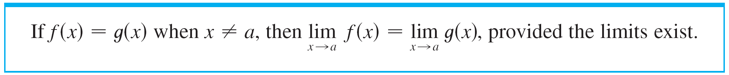
Note
In general, we have the following useful fact.

Slide 21
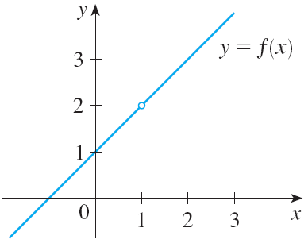
Example 3
Find where .
SOLUTION:
Here, g is defined at x = 1 and .
However, the value of a limit as x approaches 1 does not depend on the value of the function at 1.
Since g(x) = x + 1 for , we have:

Slide 22
Example 3 – Solution
Note that the values of the functions in Examples 3 and 4 are identical except when x = 1. So, they have the same limit as x approaches 1.

Slide 23
Example 4
Evaluate
SOLUTION:
If we define , we can’t compute by letting h = 0 since F(0) is undefined.
However, if we simplify F(h) algebraically, we find that:

Slide 24
Example 4 – Solution
Recall that we consider only h ≠ 0 when letting h approach 0.
Thus,

Slide 25
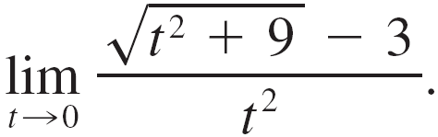
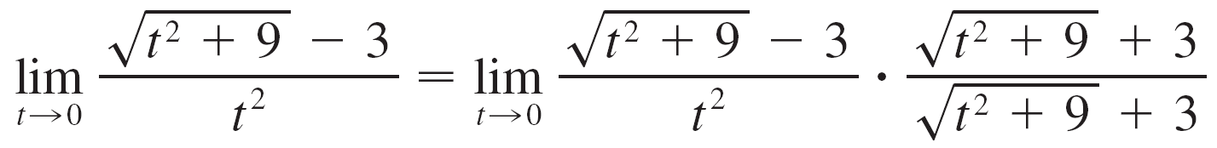
Example 5
Find
SOLUTION:
We can’t apply the Quotient Law immediately, since the limit of the denominator is 0.
Here the preliminary algebra consists of rationalizing the numerator:

Slide 26
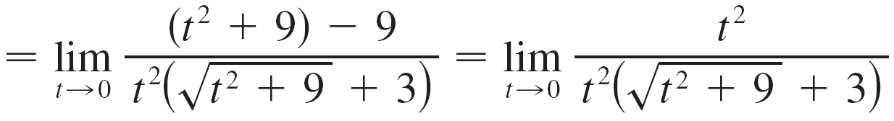
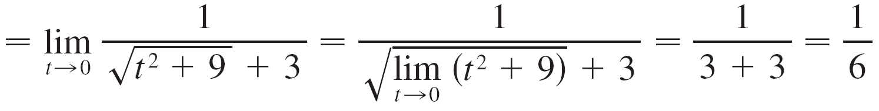
Example 5 – Solution
cont’d

Slide 27
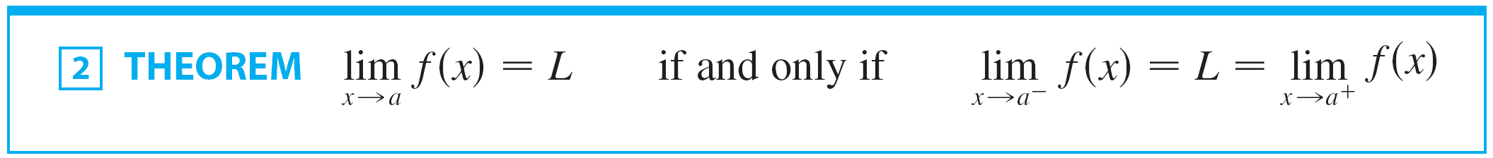
Theorem 2
Some limits are best calculated by first finding the left- and right-hand limits.
The following theorem says that a two-sided limit exists if and only if both of the one-sided limits exist and are equal.
When computing one-sided limits, we use the fact that the Limit Laws also hold for one-sided limits.

Slide 28

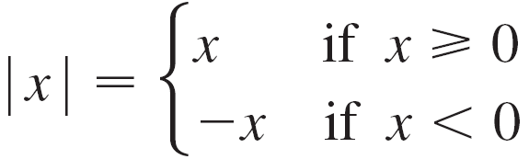

Example 6
Show that
SOLUTION:
We know that
Since for |x| = x, we x > 0 have

Slide 29


Example 6 – Solution
cont’d
For x < 0 we have |x| = –x and so
Therefore, by Theorem 2,
The result looks plausible from the figure.

Slide 30
Example 7
Prove that does not exist.
SOLUTION:
Since the right- and left-hand limits are different, it follows from
Theorem 2 that does not exist.

Slide 31
Example 7 – Solution
The graph of the function is shown in the figure. It supports the one-sided limits that we found.

Slide 32






Example 8
The greatest integer function is defined by = the largest integer that is less than or equal to x.
(For instance,
)
Show that does not exist.

Slide 33
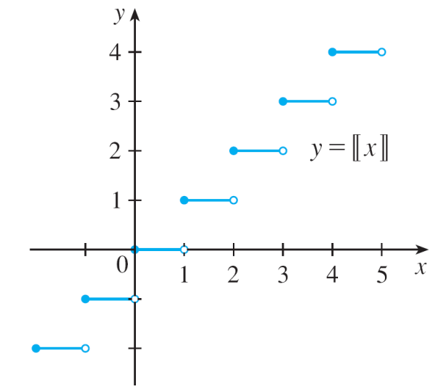
Example 8 – Solution
The graph of the greatest integer function is shown in Figure 5.
Greatest integer function
Figure 5

Slide 34







Example 8 – Solution
Since for , we have
Since for , we have
Because these one-sided limits are not equal, does not exist by Theorem 2.

Slide 35
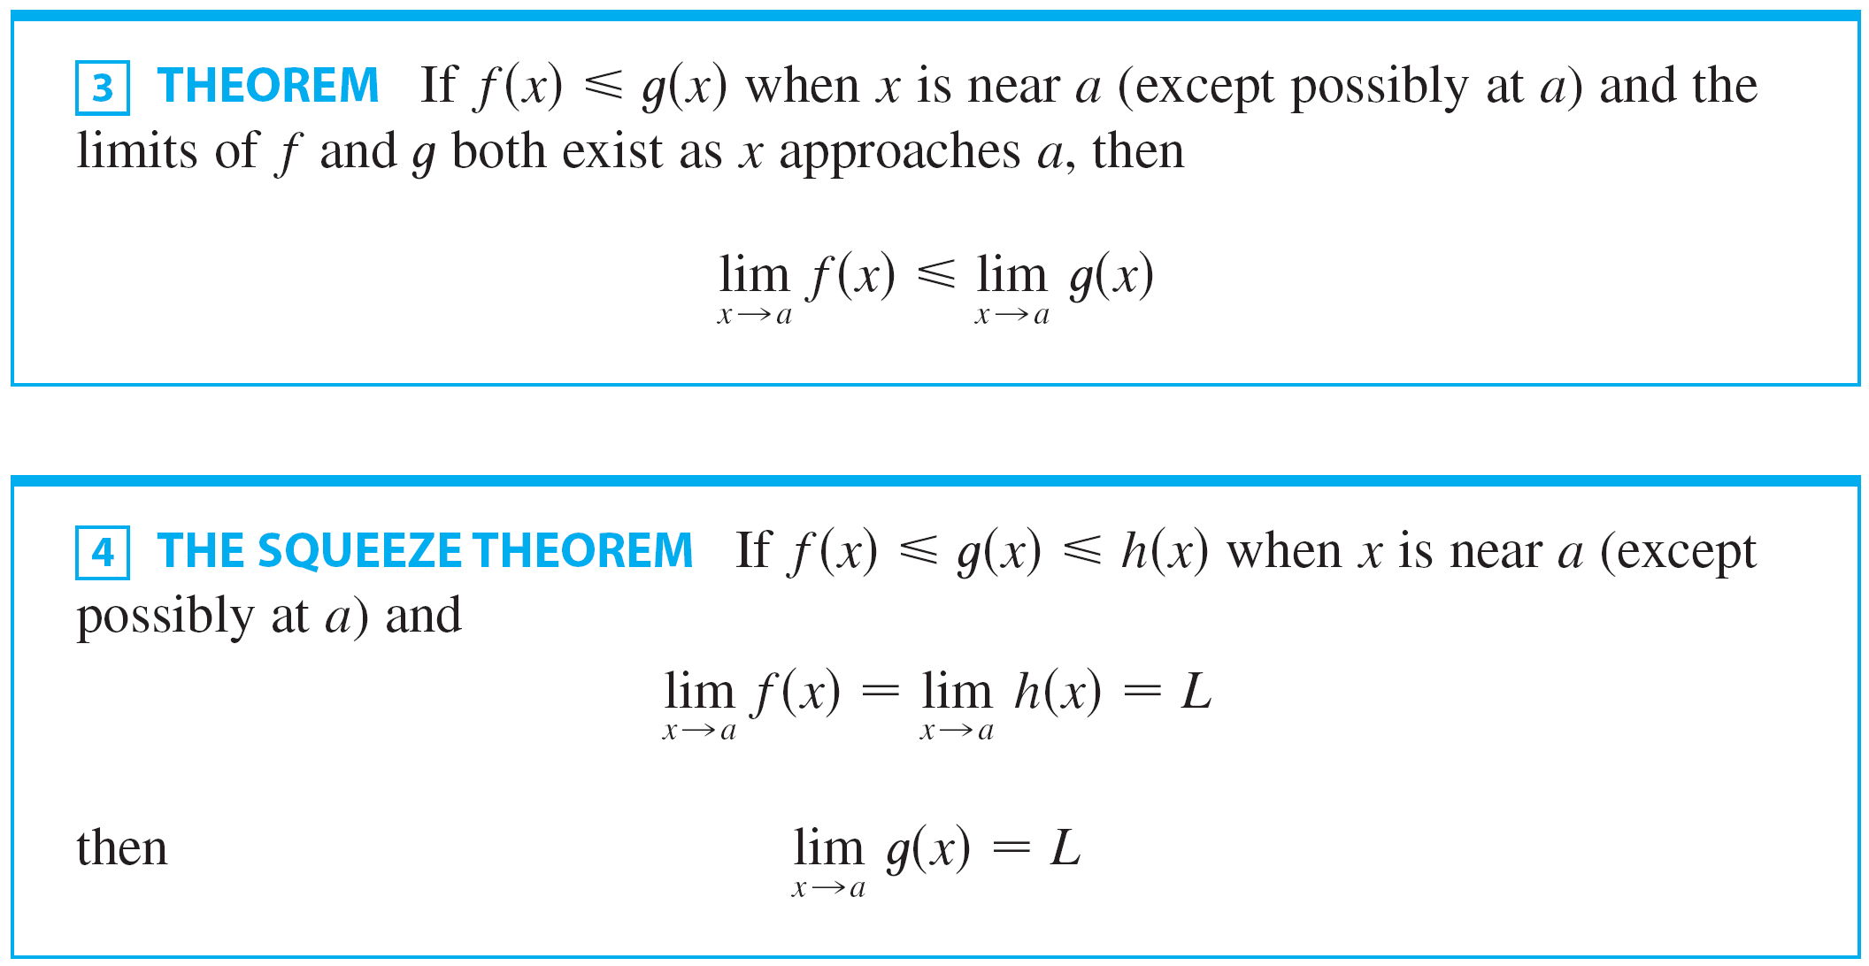
Calculating Limits
The next two theorems give two additional properties of limits.

Slide 36
THE SQUEEZE THEOREM
The Squeeze Theorem is sometimes called the Sandwich Theorem or the Pinching Theorem.
The theorem is illustrated by the Figure 6.
It states that, if g(x) is squeezed between f(x) and h(x) near a and if f and h have the same limit L at a, then g is forced to have the same limit L at a.

Slide 37
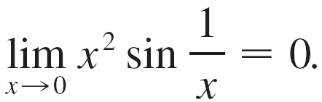
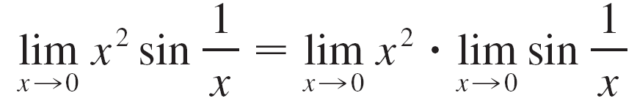

Example 9
Show that
Solution :
First note that we cannot use
because does not exist.

Slide 38
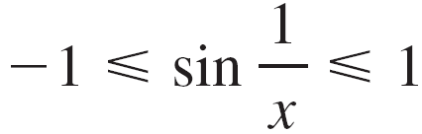

Example 9 – Solution
cont’d
Instead we apply the Squeeze Theorem, and so we need to find a function f smaller than g (x ) = x ² sin(1/x ) and a function h bigger than g such that both f (x ) and h (x ) approach 0.
To do this we use our knowledge of the sine function. Because the sine of any number lies between –1 and 1, we can write
Any inequality remains true when multiplied by a positive number.

Slide 39

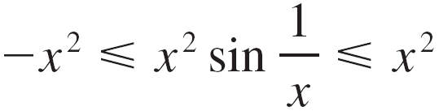
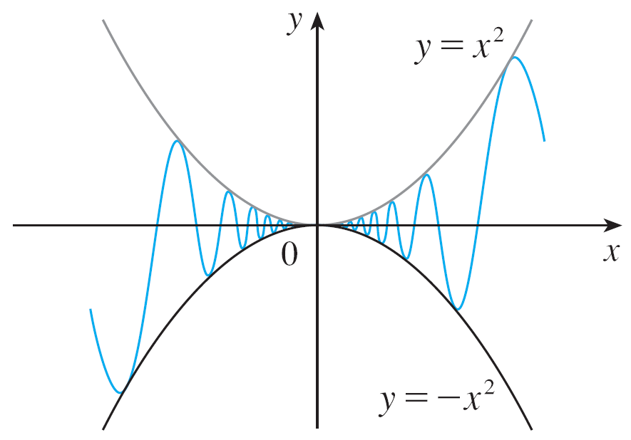
Example 9 – Solution
cont’d
We know that x ² ≥ 0 for all x and so, multiplying each side of the inequalities in by x ², we get
as illustrated by Figure 7.
y = x²sin(1/x)
Figure 7

Slide 40
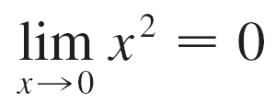


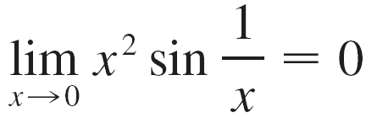
Example 9 – Solution
cont’d
We know that
and
Taking and in in
the Squeeze Theorem, we obtain

Slide 41

DERIVATIVES OF TRIG. FUNCTIONS
On the basis of numerical and graphical evidence, we know that
We now use a geometric argument to prove Equation.
Assume first that θ lies between 0 and π/2.

Slide 42
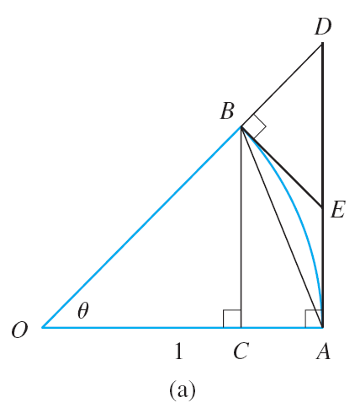
DERIVATIVES OF TRIG. FUNCTIONS
The figure shows a sector of a circle with center O, central angle θ, and radius 1. BC is drawn perpendicular to OA.
By the definition of radian measure, we have arc AB = θ.
Also, |BC| = |OB| sin θ = sin θ.

Slide 43
DERIVATIVES OF TRIG. FUNCTIONS
From the diagram we see that |BC| < |AB| < arc AB
Therefore

Slide 44
DERIVATIVES OF TRIG. FUNCTIONS
Let the tangent lines at A and B intersect at E.
You can see from this Figure 8(b) that the circumference of a circle is smaller than the length of a circumscribed polygon.
So, arc AB < |AE| + |EB|

Slide 45
DERIVATIVES OF TRIG. FUNCTIONS
Thus, θ = arc AB < |AE| + |EB| < |AE| + |ED| = |AD| = |OA| tan θ = tan θ
Therefore, we have: So,

Slide 46
DERIVATIVES OF TRIG. FUNCTIONS
We know that .
So, by the Squeeze Theorem, we have:

Slide 47
DERIVATIVES OF TRIG. FUNCTIONS
However, the function (sin θ)/θ is an even function.
So, its right and left limits must be equal.
Hence, we have:

Slide 48
Example 10
Find
Solution :
In order to apply Equation 5, we first rewrite the function by multiplying and dividing by 7:

Slide 49
Example 10 SOLUTION
If we let θ = 7x, then θ → 0 as x → 0, we have 7x → 0. So, by Equation 5, we have:

Slide 50
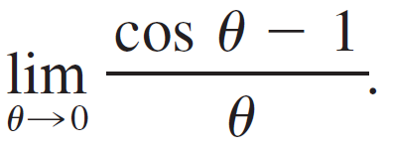
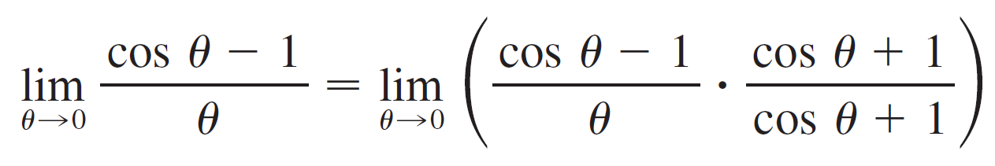
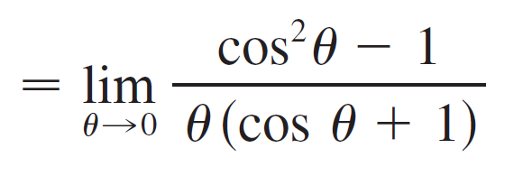
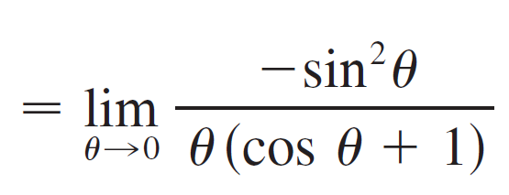
Example 11
Evaluate
Solution :

Slide 51
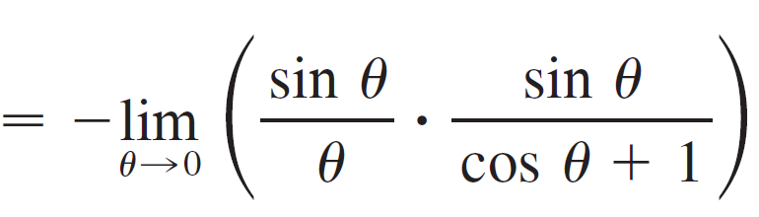
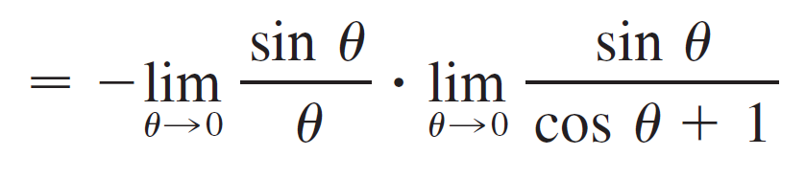
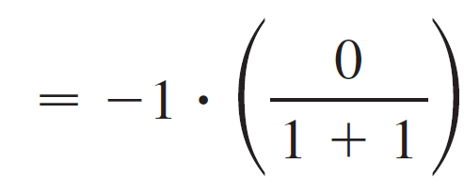


Example 11 – Solution

